Slide 1
3D Modeling Overview
Modeling Techniques and Tools

Slide 2
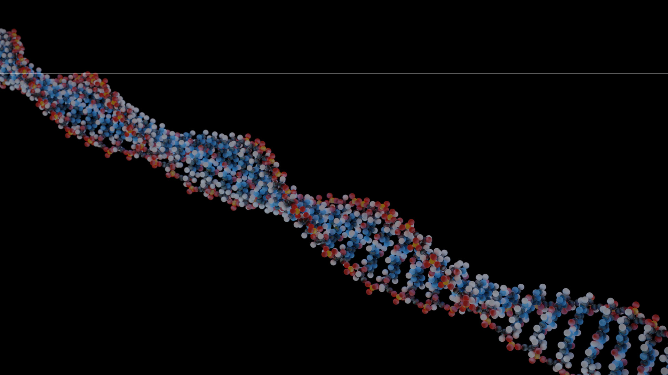

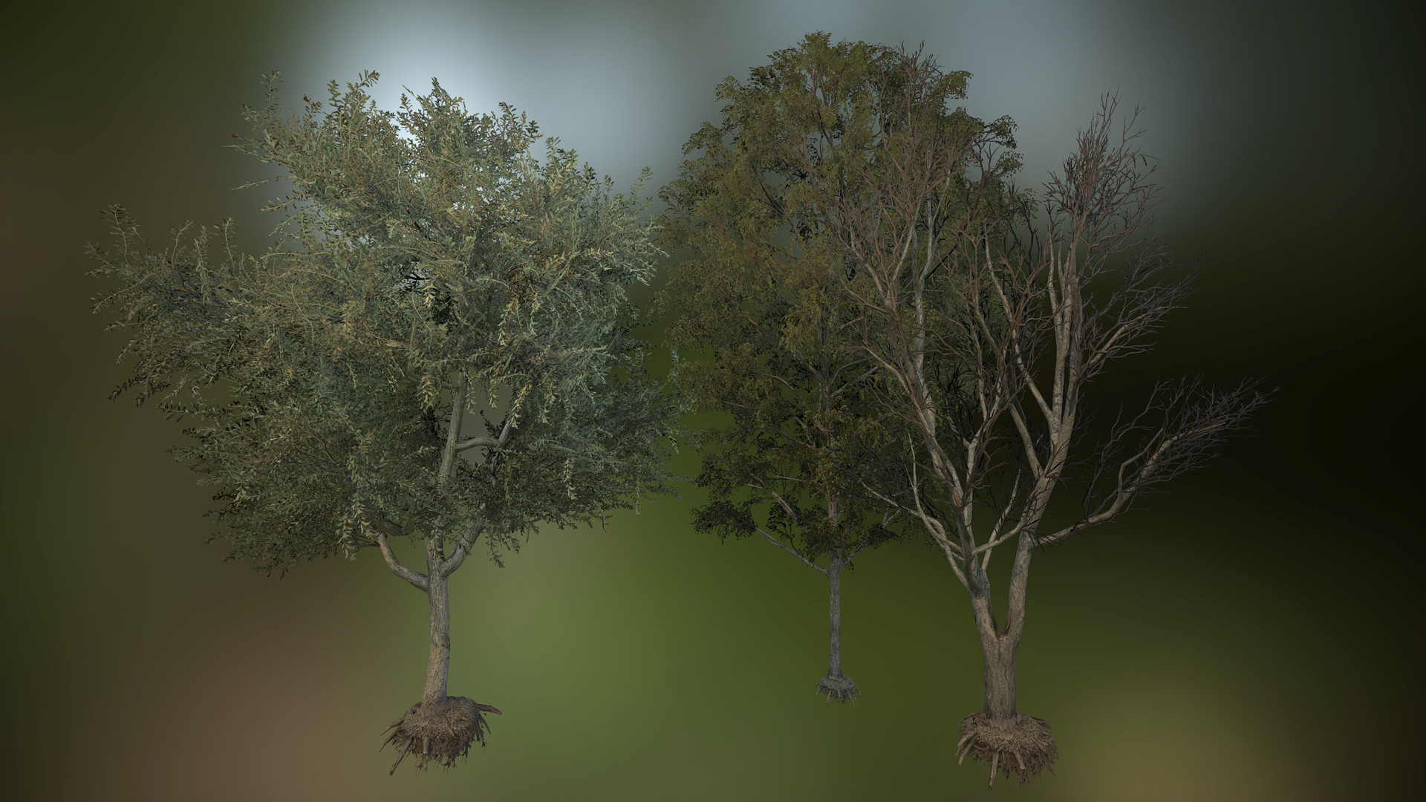


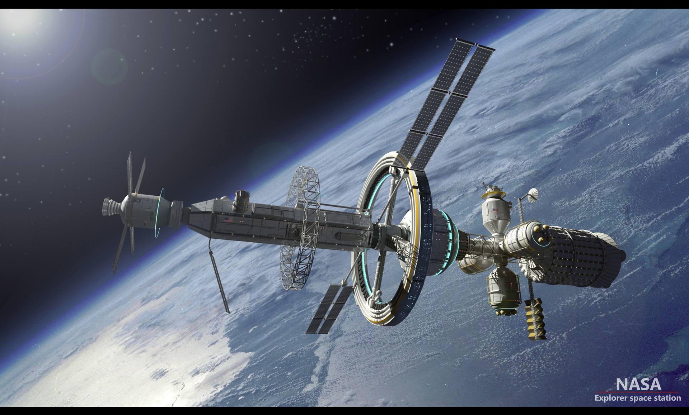

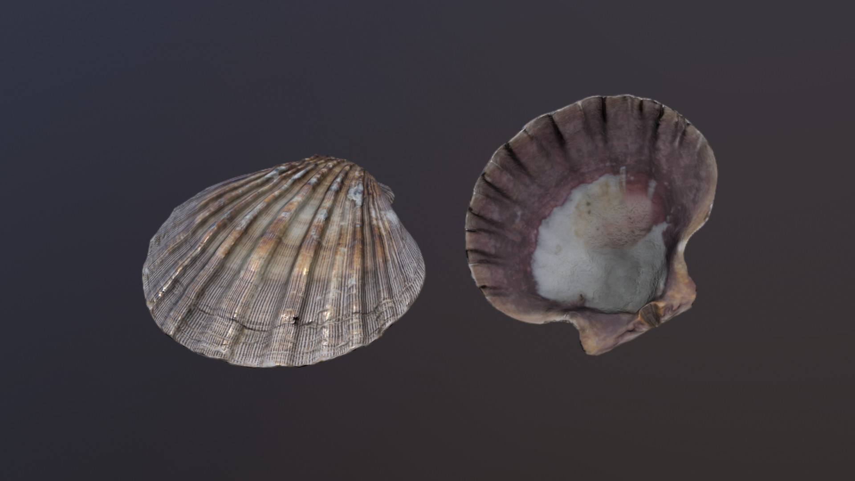
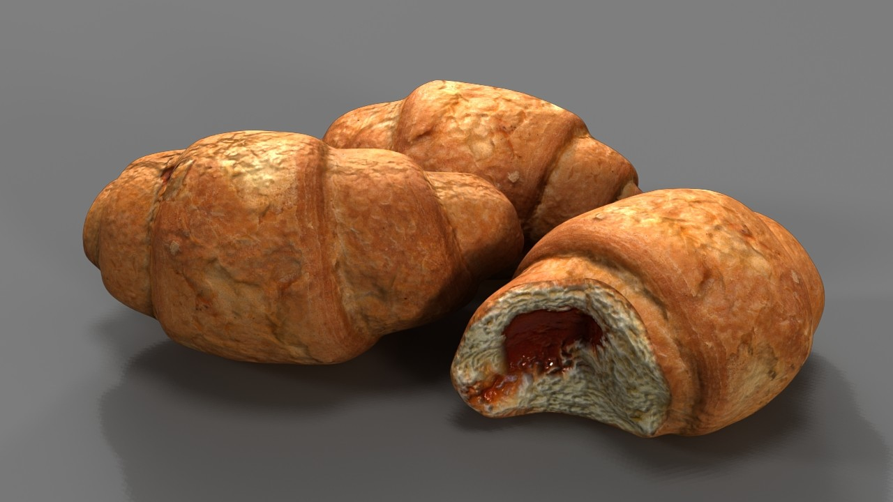
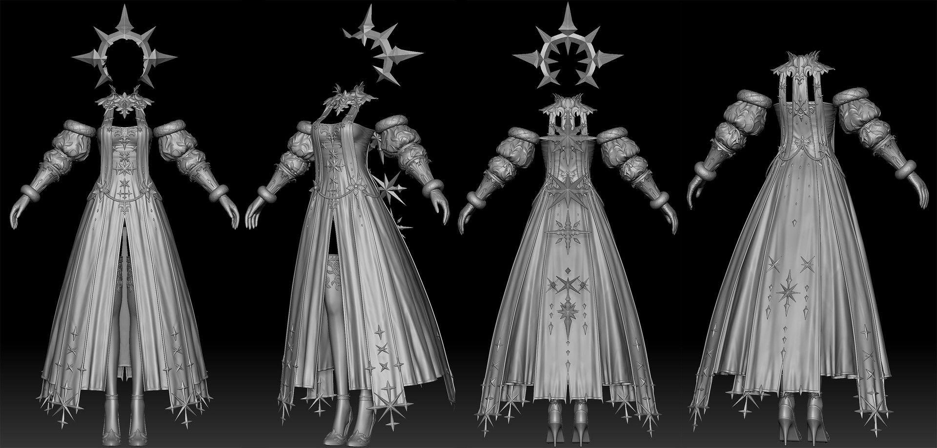
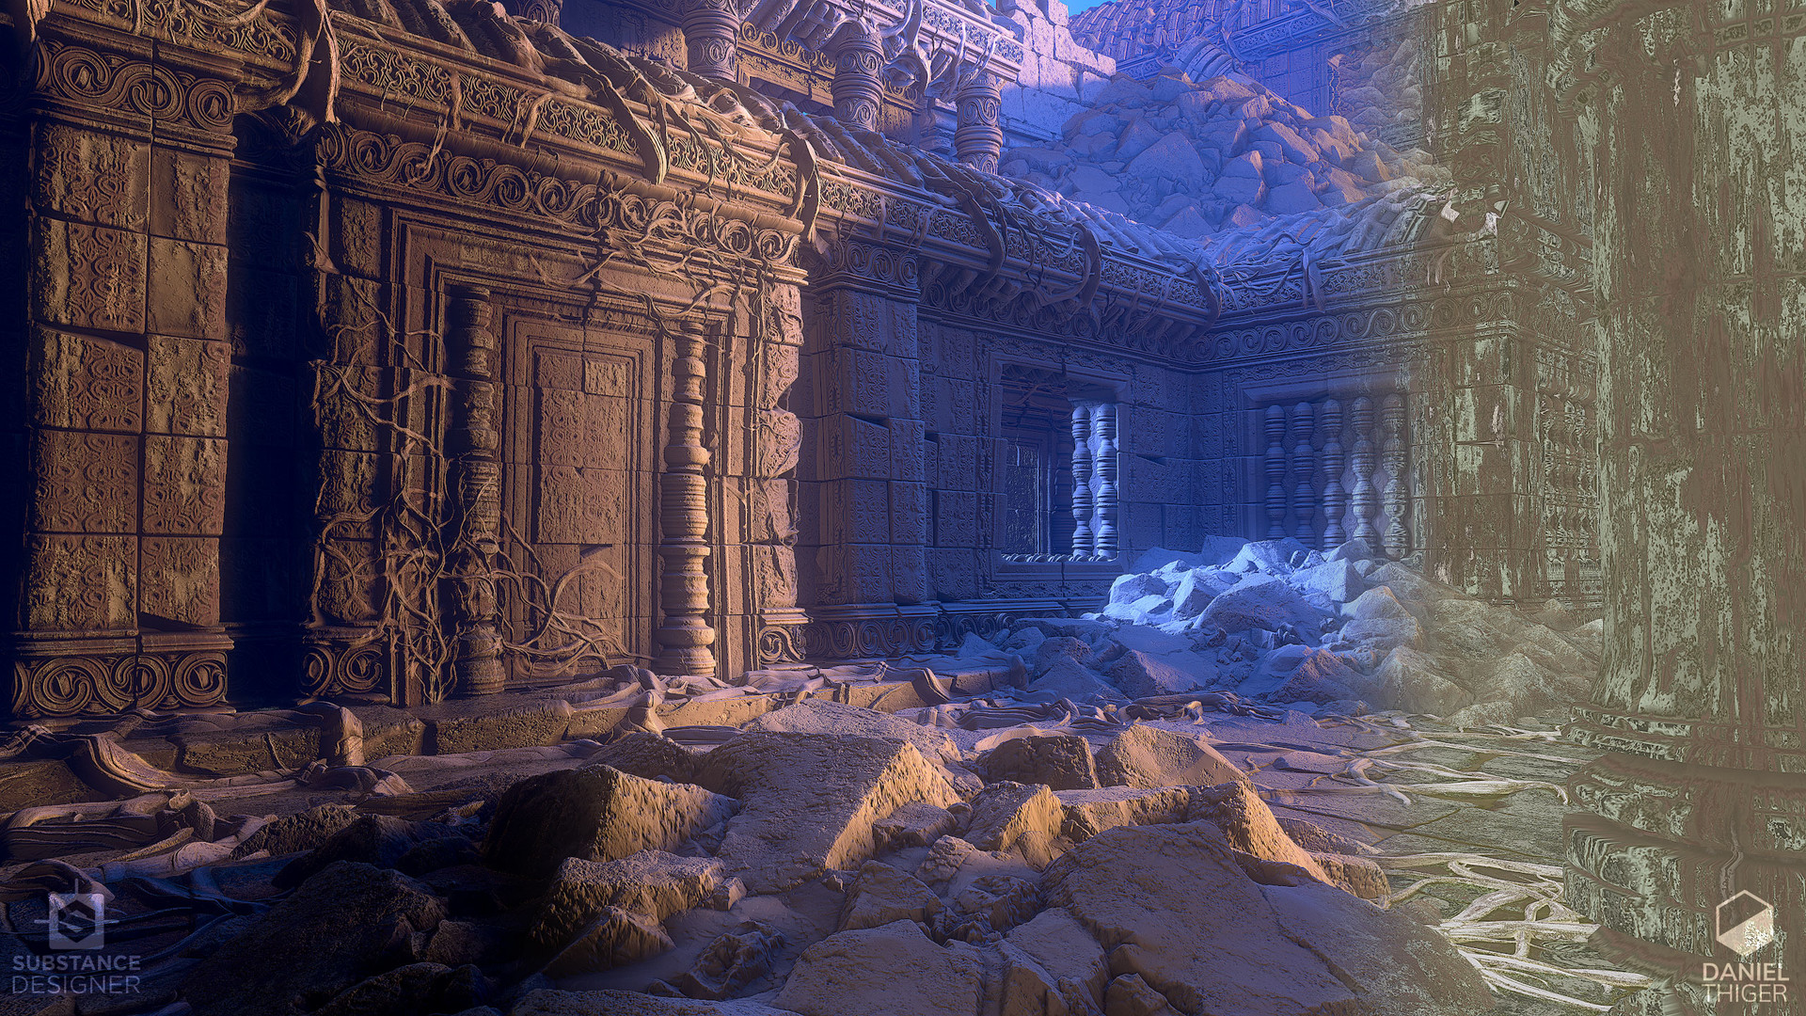
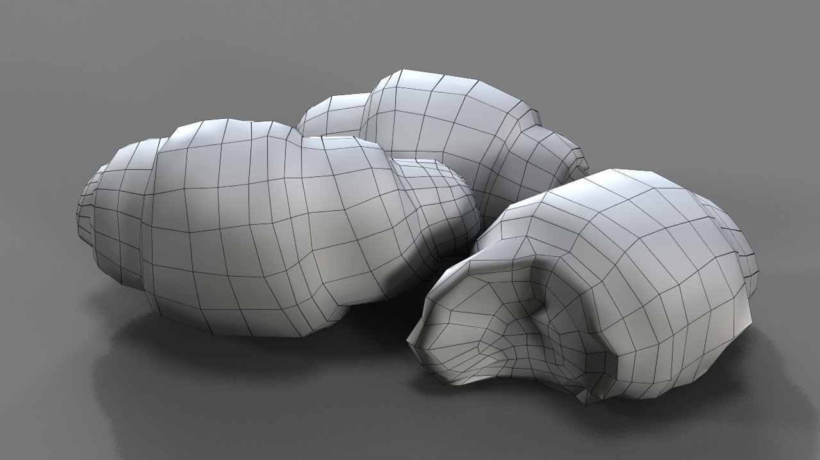
What is 3D Modeling
Creation of digital 3D assets
Notes:
This entire PowerPoint is loosely based on this video https://youtu.be/DeHasEMCzcc which goes through 20+ modeling techniques in 22 mins.
Credits:
Zhong Zhou: https://www.artstation.com/artwork/3odbzA
Hideyuki Ashizawa: https://www.artstation.com/artwork/w86r2X
Kyungmin Kim: https://www.artstation.com/artwork/8lerWw
Helen Rivnaya: https://www.artstation.com/artwork/Yaee1b
Matteo Cannatella: https://www.artstation.com/artwork/9em3QW
Mister Pibody: https://www.artstation.com/artwork/4b8aNl
Abigail Jones: https://www.artstation.com/artwork/rRA9dL
Daniel Thiger: https://www.artstation.com/artwork/xzAB5E
Sebastian Kopacz:
https://www.artstation.com/artwork/y969K
https://www.artstation.com/artwork/3RoE2
https://www.artstation.com/artwork/vN1zx

Slide 3

Primary Techniques
Notes:
These are the most commonly used techniques for 3D modeling in blender and some familiarity with all of them is strongly recommended.
Blender basics tutorial:
https://youtu.be/Eaw1dUypknU

Slide 4
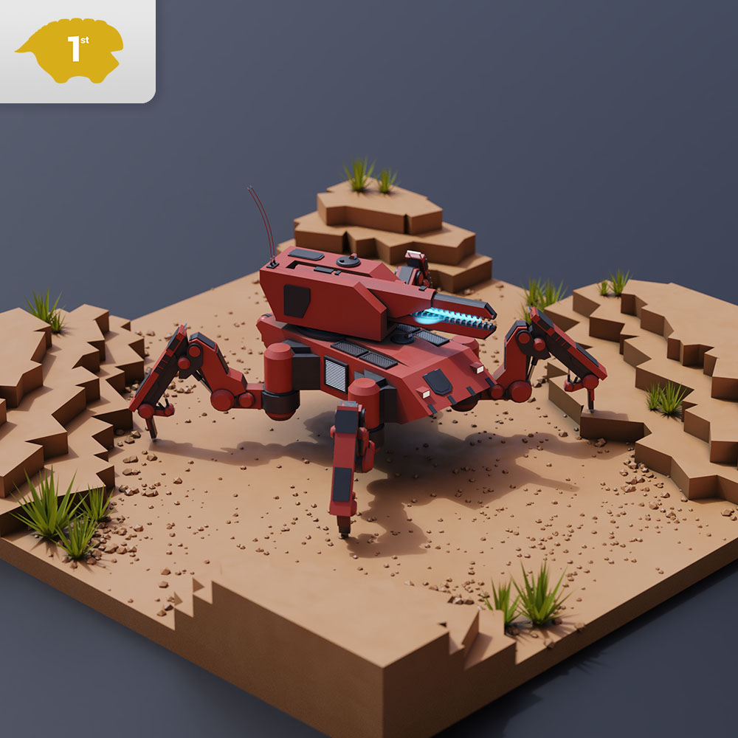
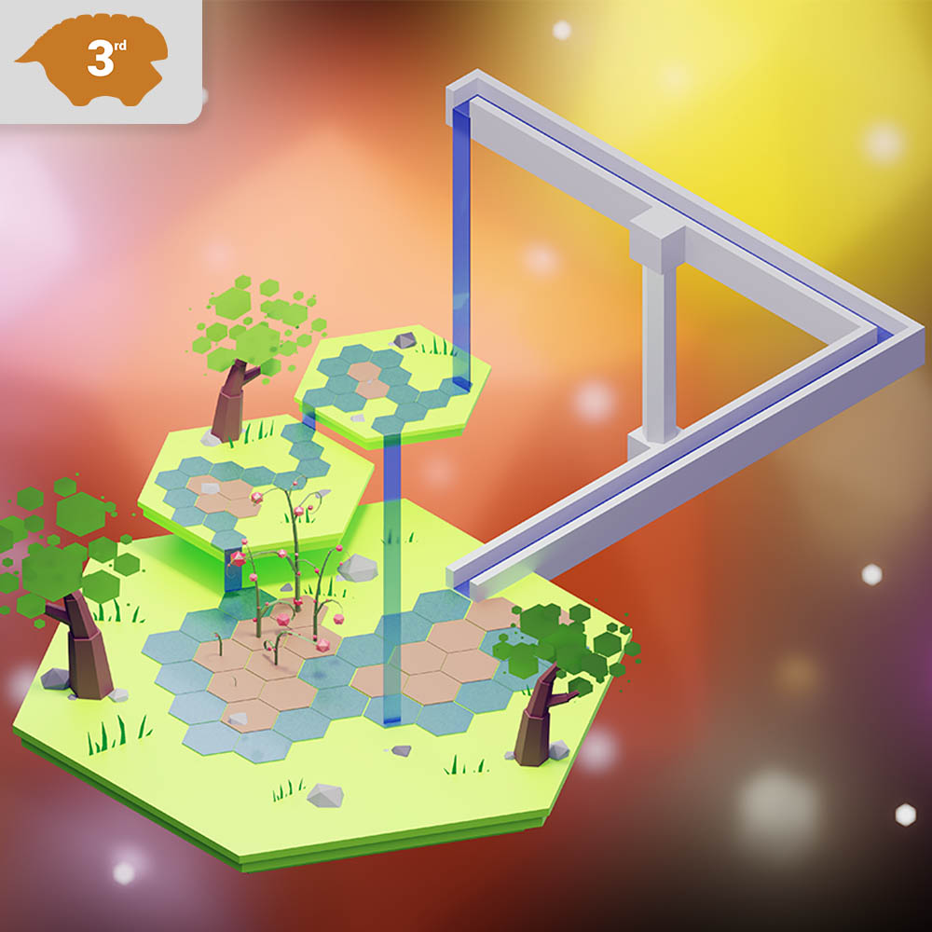
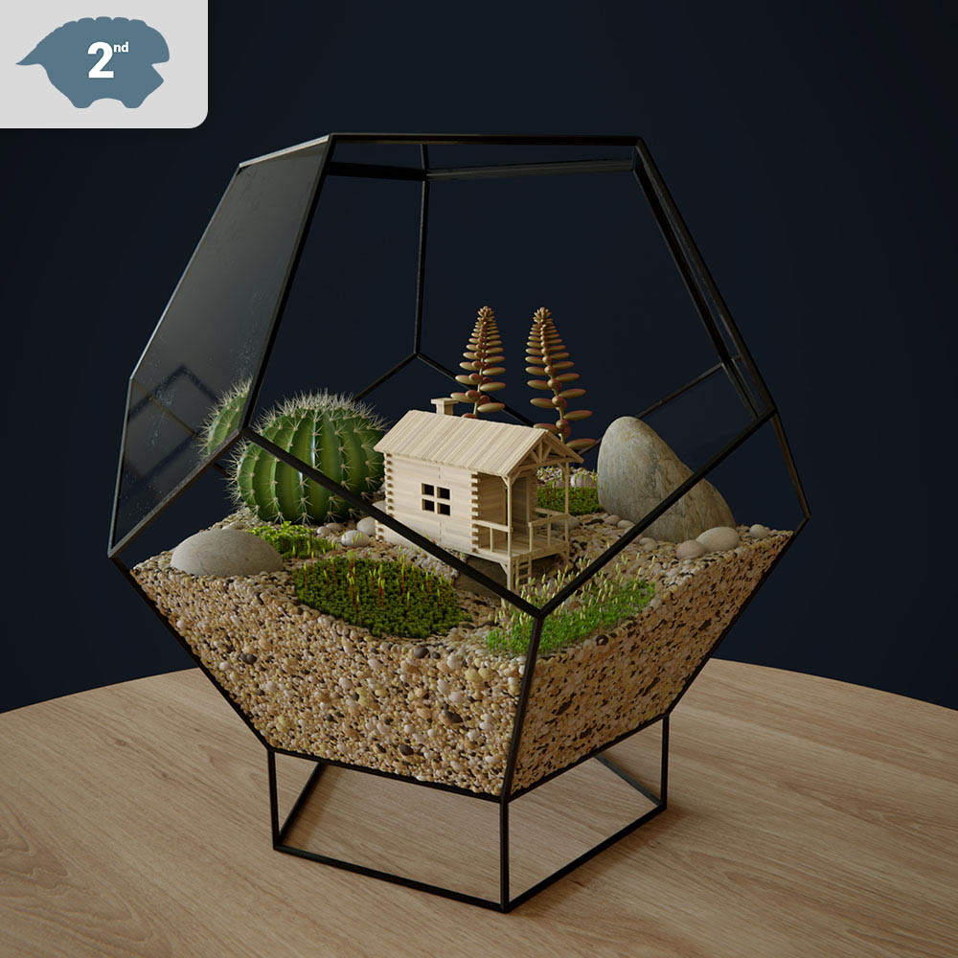
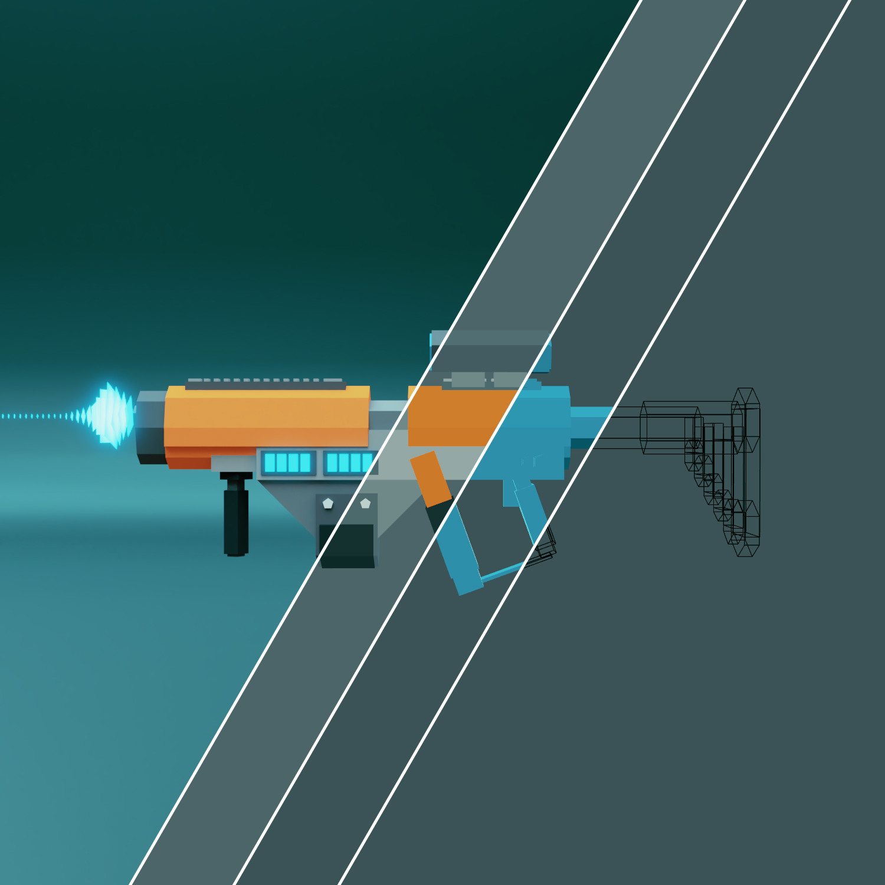
Object Manipulation
Operations applied to a collection of vertices
Rotation, Translation, Scale
Level/scene design
Uses premade assets
Can’t manipulate individual vertices
Notes:
All assets in the images were created out of default/primitive blender objects without the use of edit mode.
In blender the default object mode has all the features that object manipulation uses.
This is often what a level designer will be doing in game where they have existing assets and are just positioning them in an interesting and novel way.
Kit bashing would also fall under this category.
Tutorials:
https://youtu.be/JYj6e-72RDs
Credits, winners of Remington’s simplicity challenge #1 (Primitive modeling challenge):
Jan Hosenfelder: https://remingtongraphics.net/other/ss2018-challenge1-winners/
Gaël Thébault: https://remingtongraphics.net/other/ss2018-challenge1-winners/
Garrison Keeton: https://remingtongraphics.net/other/ss2018-challenge1-winners/
Grant Wilk: https://www.artstation.com/artwork/onQrO

Slide 5
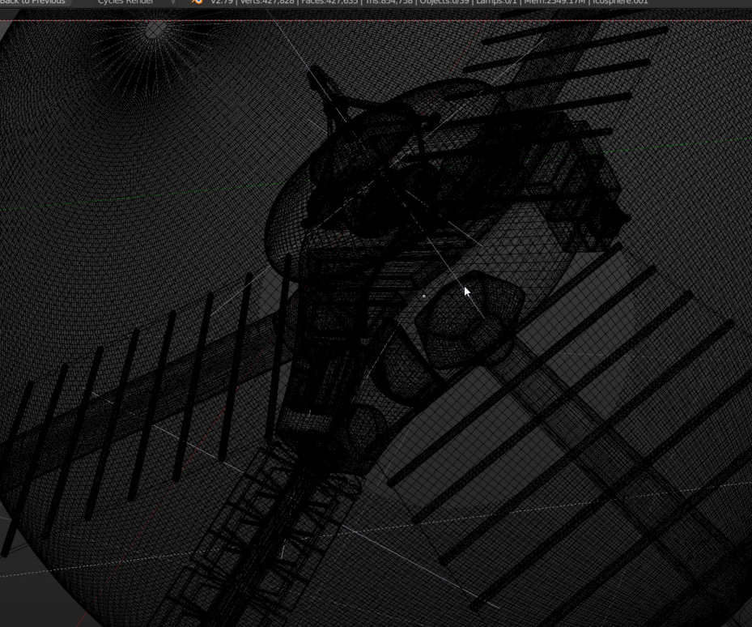

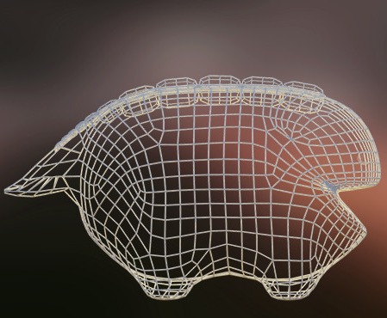
Mesh Manipulation
Create and modify vertices
Individually or in groups
Preferably all faces have 4 vertices
Can be tedious or difficult if used alone with lots of vertices
Generally combined with modifiers
Notes:
In blender the features for mesh manipulation are accessible in edit mode.
Generally you want to use quads.
Easier to animate
Easier to continue modeling
Tutorials:
https://youtu.be/yi87Dap_WOc
Credits:
Grant Wilk:
https://www.artstation.com/artwork/aKOPk
https://www.artstation.com/artwork/W4JmJ
Sebastian Kopacz: https://www.artstation.com/artwork/y969K

Slide 6


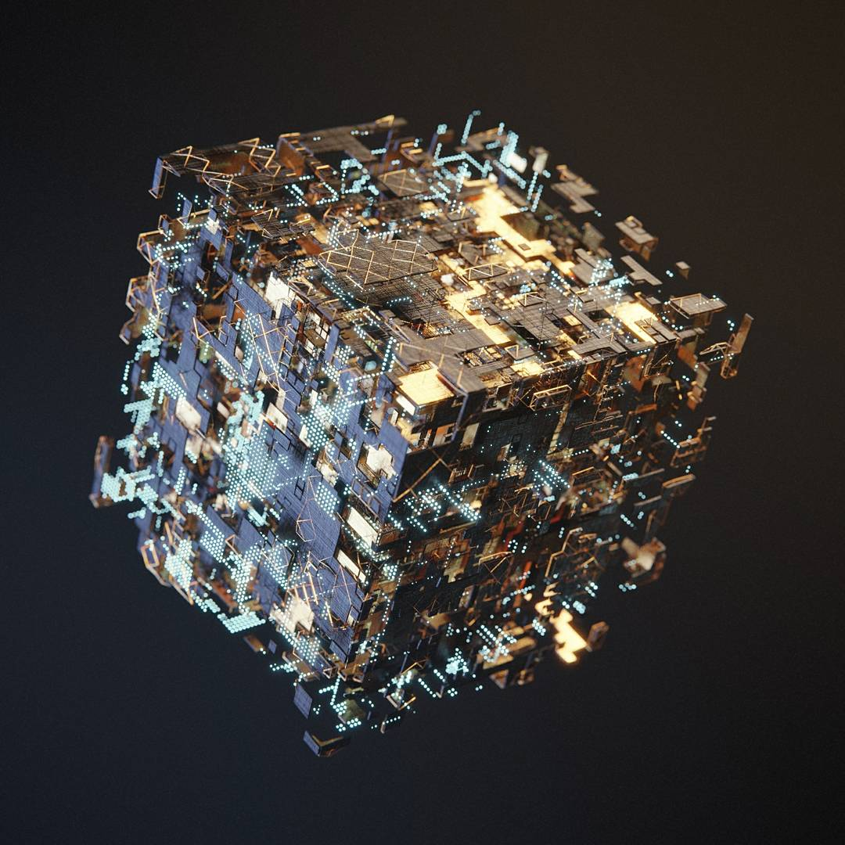
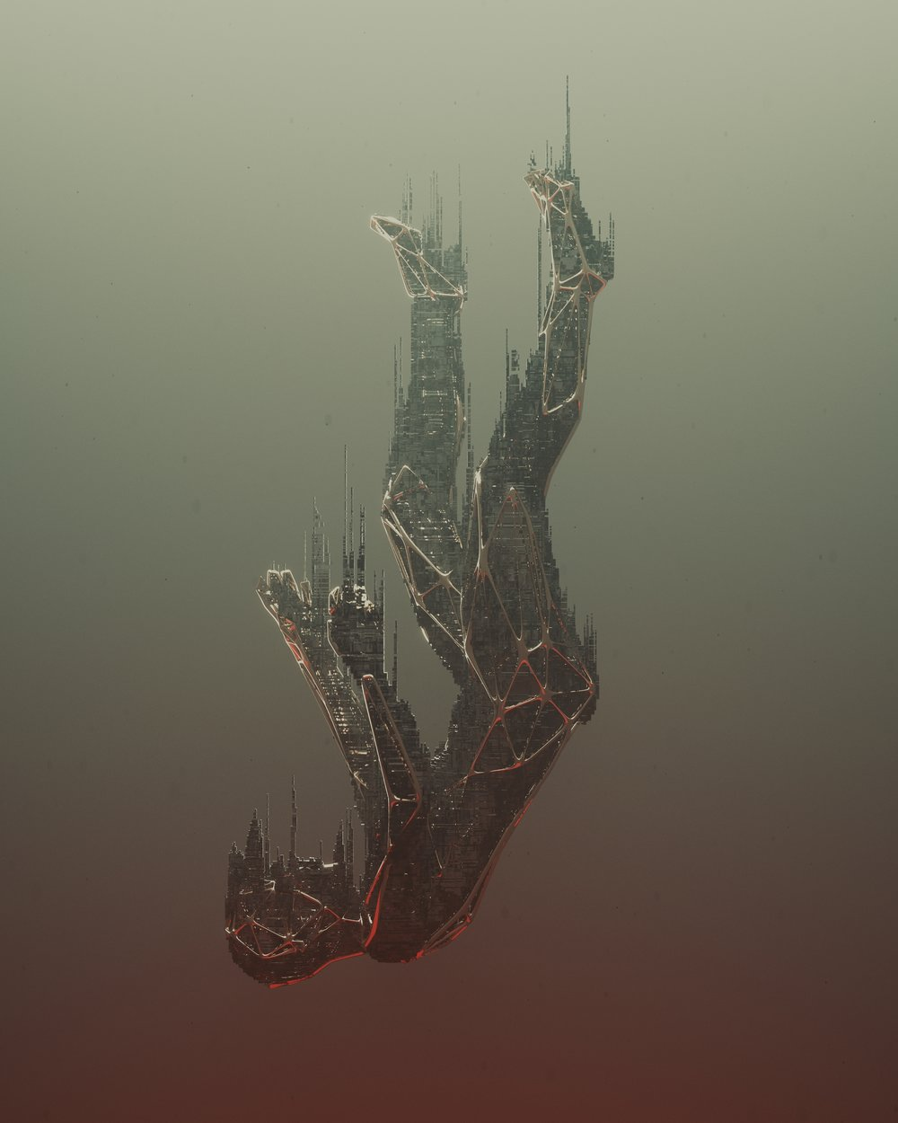
Modifiers
Automatic operations that are used to affect a mesh
Commonly used modifiers:
Subsurface, Bevel, Array, Solidify, Mirror, Boolean
Can be layered to produce interesting effects
Can result in way too many polygons or bad topology
Notes:
Blender has 4 types of modifiers.
- Generally when modeling with mesh editing, the modifiers in the generate category are the most useful.
Immensely speeds up and simplifies the modeling process.
Tutorials/Resources:
https://youtu.be/7ndd_qNYf3Y
https://youtu.be/j5WHEG9OtHo
https://youtu.be/cb7M72_a2ko
https://docs.blender.org/manual/en/latest/modeling/modifiers/index.html
Credits:
Sebastian Kopacz: https://www.artstation.com/artwork/y969K
Midge Mantissa Sinnaeve: https://mantissa.xyz/

Slide 7

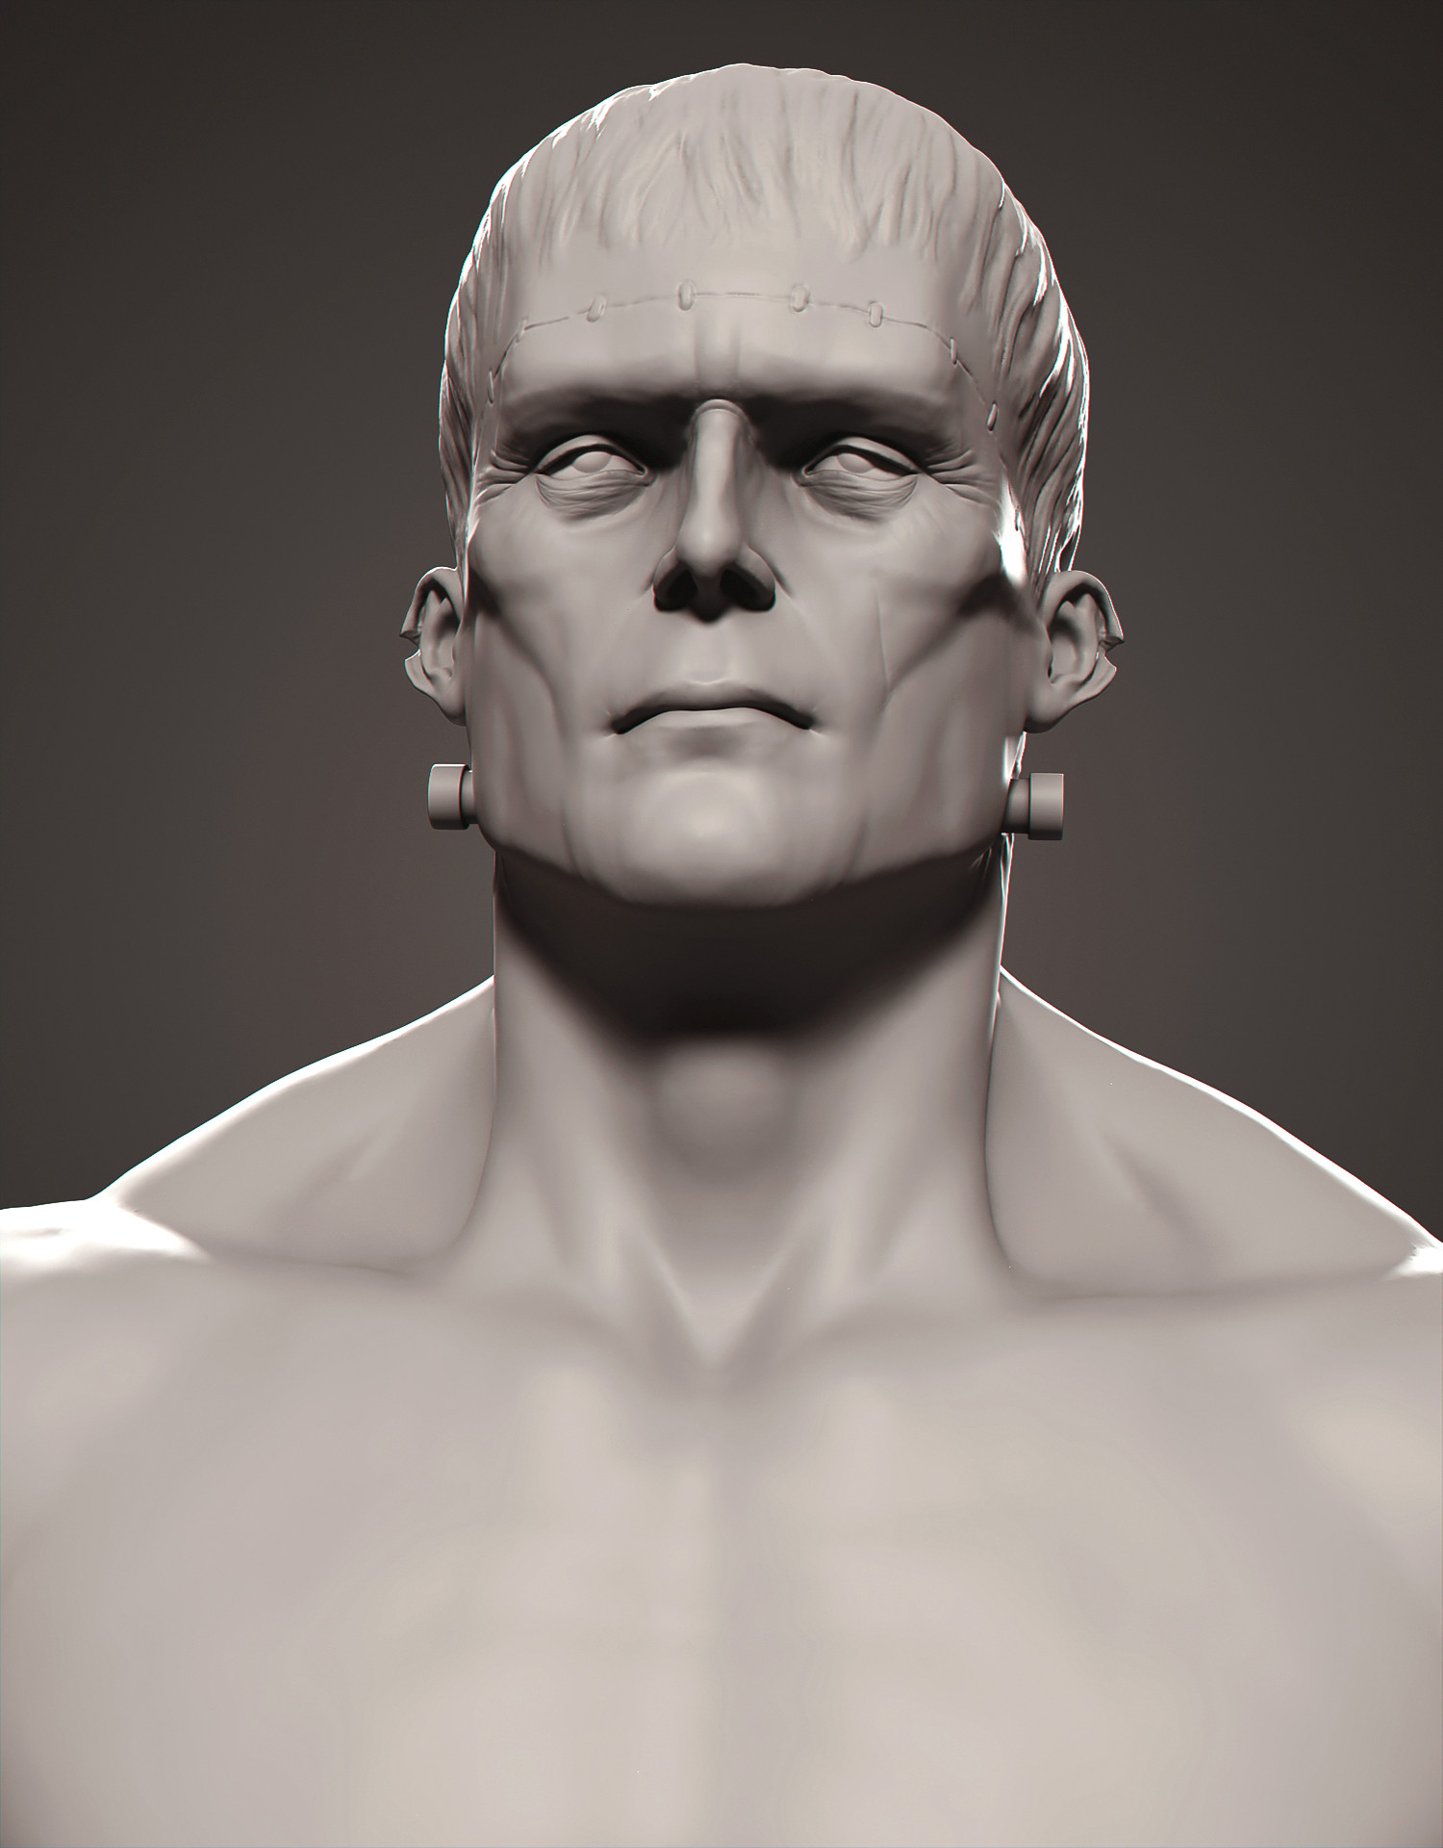
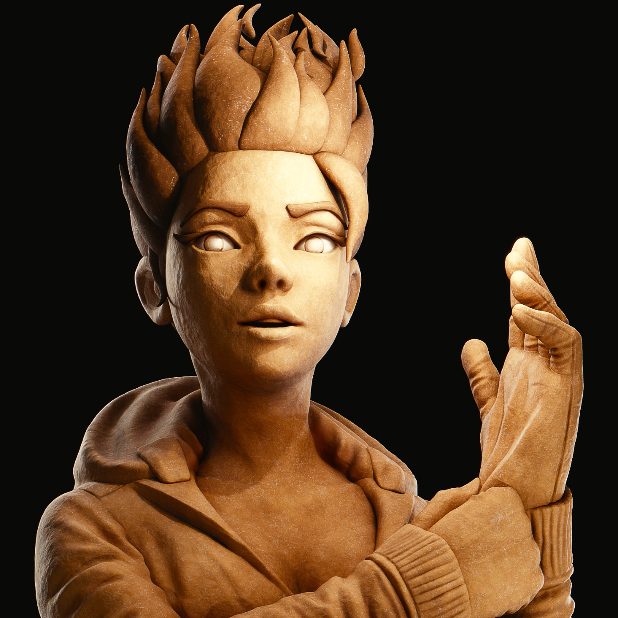
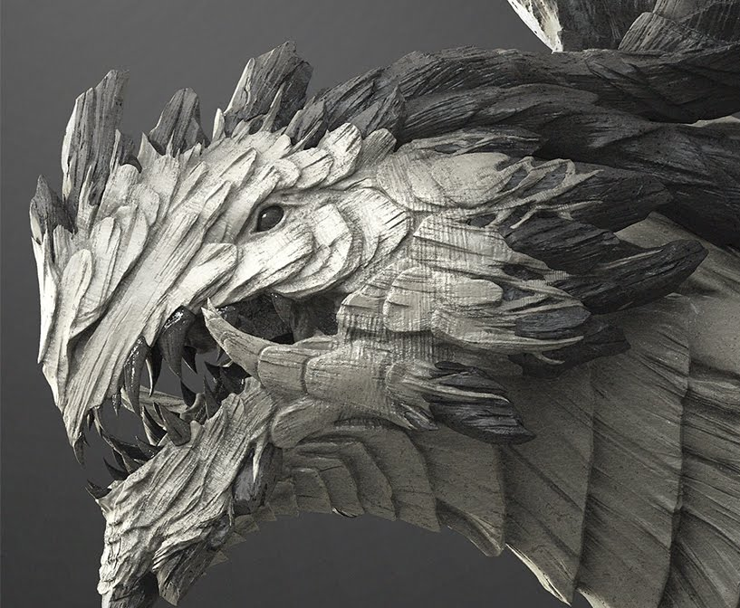
Sculpting
Akin to real life clay sculpting
Usually used for organic models like people or animals
Can be used for terrain or cloth
Easier with a tablet due to pressure sensitivity
Often needs to be retopologized afterwards due to bad topology
Notes:
Tutorials:
https://www.youtube.com/channel/UCfjswDVU0XHyBN7UFG0Mi5Q
https://youtu.be/9q2Ied337zk
Credits:
Gregory Coelho: http://www.boulp.com/
Zacharias Reinhardt: https://www.artstation.com/artwork/Zq9om
Yanal Sosak:
https://www.artstation.com/artwork/Wr03N
https://www.artstation.com/artwork/A993y5

Slide 8
Supplementary Techniques
Notes:
These are less essential but still really cool modeling techniques which can drastically speed up one’s workflow if used correctly.

Slide 9
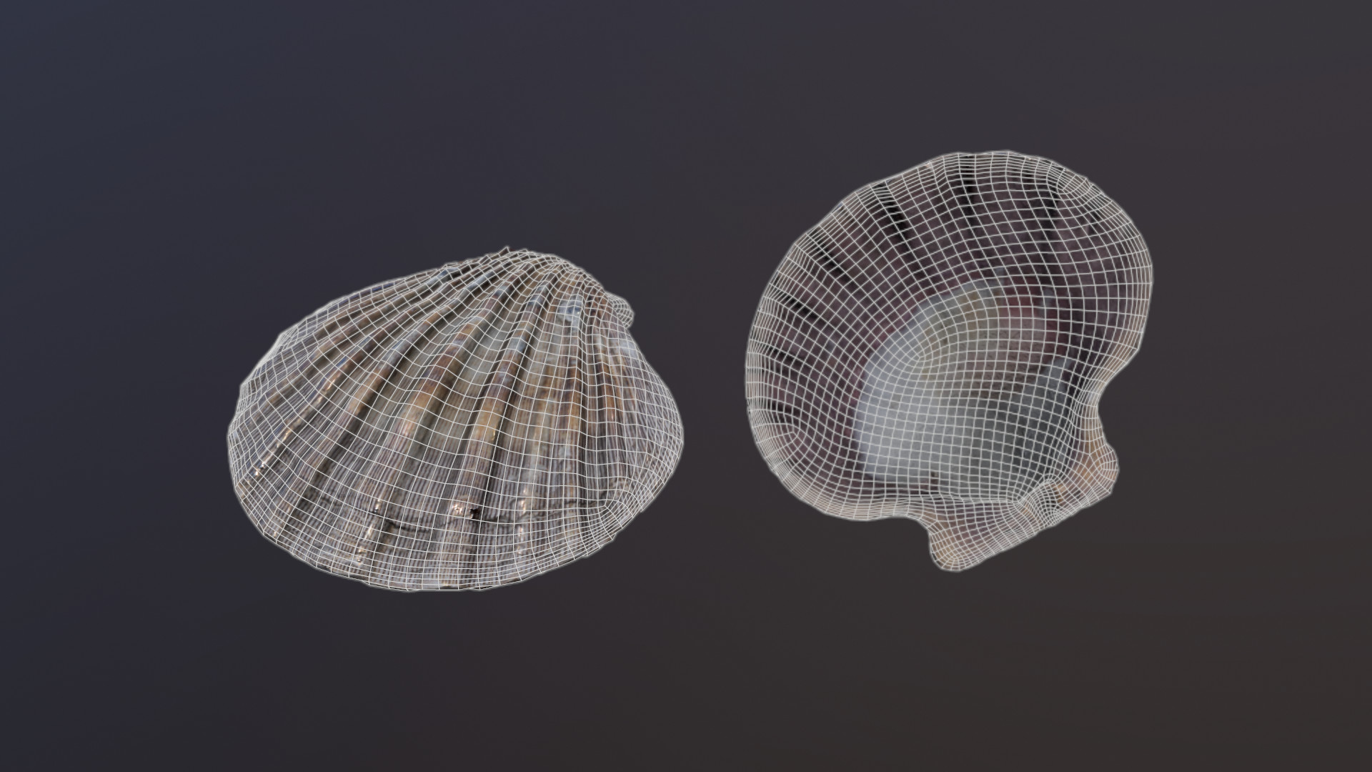
Photo Scanning
Easy for non-artists
Textures and model generated automatically from the images
Needs good pictures of a real life item
Can result in bad topology
Notes:
Tutorials:
https://youtu.be/GEAbXYDzUjU
Credits:
Abigail Jones: https://www.artstation.com/artwork/rRA9dL

Slide 10

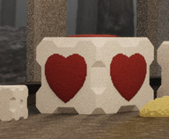

Mathematical and Meta-Objects
Use math to create and modify objects
Sphere centered at the origin and with radius 1 is defined by $x^{2}+y^{2}+z^{2}=1$
Difficult to figure out what formula to use
Meta objects will stick together when nearby
Useful for modeling fluids
Often used with procedural modeling
Notes:
In blender meta-objects can be accessed by using shift+a in object mode and selecting metaball followed by your desired meta-object
For shapes defined by math equations, a the extra objects blender addon will need to be activated.
Tutorials/Resources:
https://youtu.be/tAdoyC2ppds
Calculus 3
Computer Haptics (cpsc 599)
Modelling for Computer Graphics (cpsc 589)
Credits:
Sebastian Kopacz: https://www.artstation.com/artwork/5m8dW
Wolfram: http://mathworld.wolfram.com/HeartSurface.html

Slide 11

Curves and Surfaces
Path or surface along which vertices will be placed
Functionally equivalent to regular mesh modeling with a subsurface modifier
Can result in a high poly count if using too many subdivisions
Curves useful for pipes, rope, hair, trees, etc.
Notes:
Curves are useful for pipes, rope, hair, trees, etc
Surfaces are useful for smooth surfaces like a sports car body
In blender curves and surfaces can be created using shift+a in object mode and selecting your desired curve. Various addons extend curve functionality and allow for the automated generation of things like trees using curves.
Tutorials/Resources:
https://youtu.be/q4DbjT0ZRdk
https://youtu.be/AMXcQ2V-VGA
https://youtu.be/p1xDvnVovd4
https://youtu.be/tTvD9_fDQOQ
https://youtu.be/1drRNphACMc
Introduction to Computer Graphics (cpsc 453)
Modelling for Computer Graphics (cpsc 589)
Credits:
Jordan Tetzlaff: https://www.artstation.com/artwork/4WbX1
Sebastian Kopacz: https://www.artstation.com/artwork/y969K

Slide 12

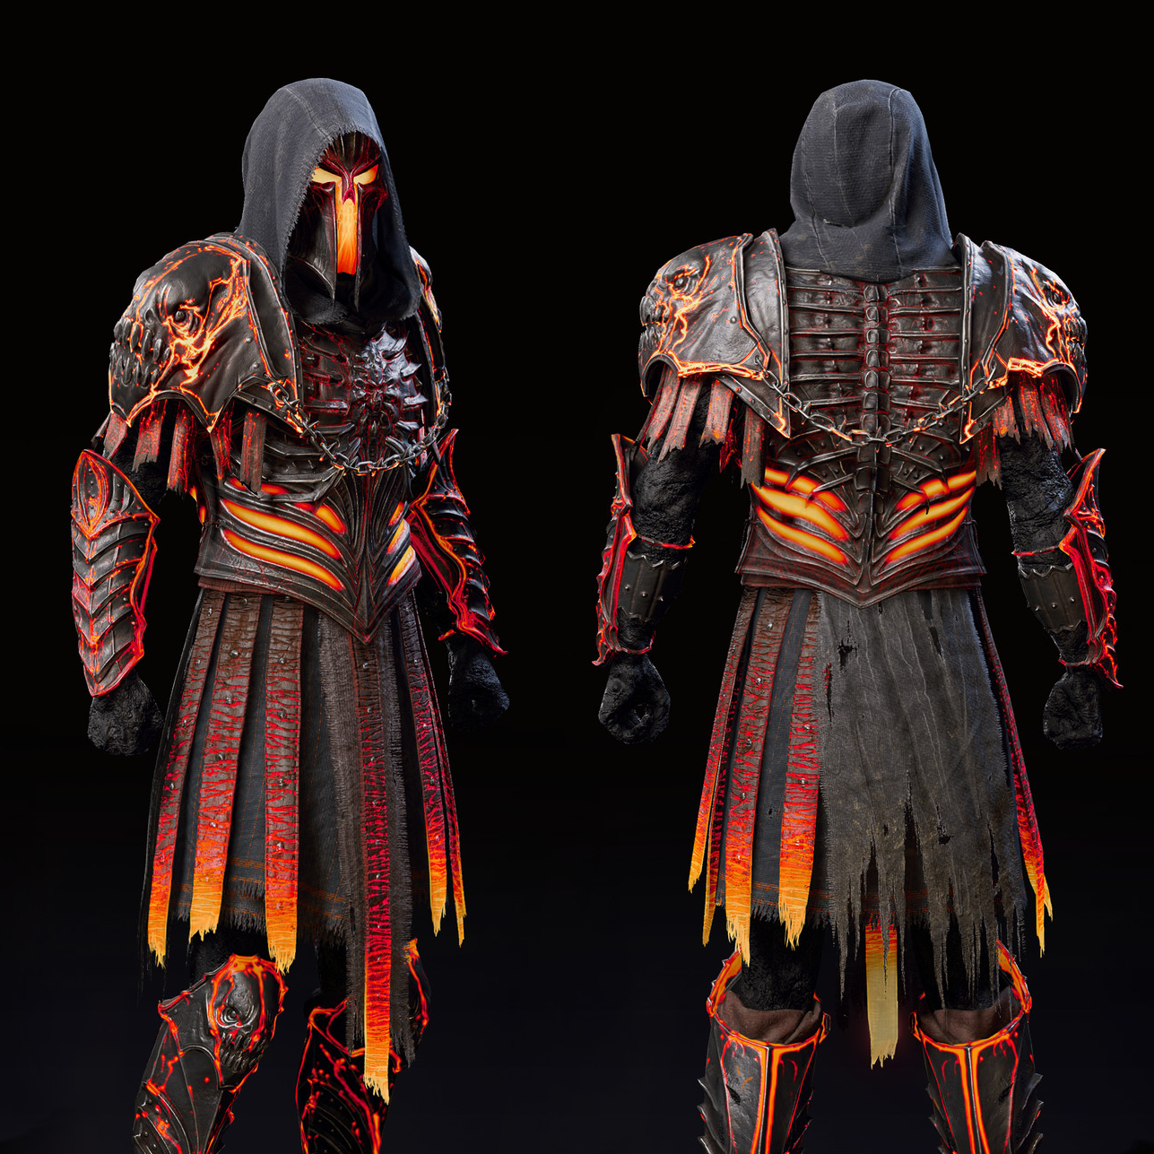

Procedural and Physics Driven
Modeling based on a ruleset
Physical interactions between various objects
Fluids, cloth, etc
Automated object placement
Cities, buildings, etc
Can take a while to generate or be difficult to write a good ruleset
Notes:
Can make use of generated or handmade assets
Often uses meta-objects (metaballs make for nice water droplets which can simulate fluids)
In blender procedural modeling can be achieved with a wide range of different tools ranging from modifiers and physics to scripting and various addons.
Tutorials/Resources:
https://www.anastasiaopara.com/
https://youtu.be/SWhPJmfLzNo
https://youtu.be/Rrx1ZJ_vFEg
https://youtu.be/TDMa7787oeA
https://youtu.be/DEo_9AopfoQ
https://youtu.be/hEf8W9RFEEY
https://youtu.be/ILT2KRF0r58
https://youtu.be/ZlPEQN0MS1o
https://youtu.be/BRFMbypQ5mM
Modelling for Computer Graphics (cpsc 589)
Fundamentals of Computer Animation (cpsc 587)
Computer Haptics (cpsc 599)
Credits:
Anastasia Opara: https://www.anastasiaopara.com/lakevillage
Gary Riley: https://www.artstation.com/artwork/GXXBkV
Grant Wilk: https://www.artstation.com/artwork/mxE2Z

Slide 13
Tools
Notes:
Here’s a list of some cool 3D modeling tools I’m aware of.

Slide 14
Blender
Free and open source
What we’ll be using in the game design club
We’ll be using blender 2.79 since as of the writing of this PowerPoint (November 2018) it is the latest version
2.80 should be finally completed sometime next year
Works for all the modeling techniques discussed here, especially when utilizing various addons.
https://www.blender.org/
Notes:
Useful blender resources:
https://discord.gg/AFD2ScV
https://www.youtube.com/user/GlebAlexandrov/
https://www.youtube.com/user/AndrewPPrice/
https://www.youtube.com/channel/UCfjswDVU0XHyBN7UFG0Mi5Q/
https://www.youtube.com/channel/UCWWybvw9jnpOdJq_6wTHryA/
https://www.youtube.com/user/Xremington04/
https://www.youtube.com/channel/UC4CmlYEHK1OaDm04U3sk2LA
https://www.youtube.com/user/T4ch1k0ma/
https://cgcookie.com/

Slide 15
Maya and 3ds Max
Paid and closed source
Industry standard for animation and modeling
https://www.autodesk.ca/en/products/maya/overview
https://www.autodesk.ca/en/products/3ds-max/overview
Notes:
FlippedNormals focuses more on art creation rather than the tools but they use all the industry standard software and sometimes make tutorials for them. https://www.youtube.com/channel/UCQQFz2LkJMoqSFTas-oozOw
Otherwise, google your own tutorials, I don’t use this software.

Slide 16
ZBrush
Paid and closed source
Excellent for sculpting
https://pixologic.com/
Notes:
FlippedNormals focuses more on art creation rather than the tools but they use all the industry standard software and sometimes make tutorials for them. https://www.youtube.com/channel/UCQQFz2LkJMoqSFTas-oozOw
Otherwise, google your own tutorials, I don’t use this software.

Slide 17
Marvelous Designer
Paid and closed source
Excellent for physics driven cloth creation
https://www.marvelousdesigner.com/
Notes:
FlippedNormals focuses more on art creation rather than the tools but they use all the industry standard software and sometimes make tutorials for them. https://www.youtube.com/channel/UCQQFz2LkJMoqSFTas-oozOw
Otherwise, google your own tutorials, I don’t use this software.

Slide 18
Houdini
Paid and closed source
Learning edition is free but can’t use it for commercial products
Excellent for procedural generation
https://www.sidefx.com/
Notes:
FlippedNormals focuses more on art creation rather than the tools but they use all the industry standard software and sometimes make tutorials for them. https://www.youtube.com/channel/UCQQFz2LkJMoqSFTas-oozOw
Otherwise, google your own tutorials, I don’t use this software.

